Slide 1
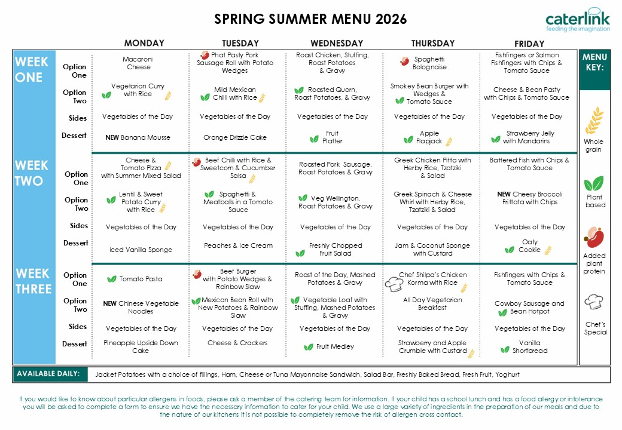
30/08/26 21/09/26
12/10/26
07/09/26
28/09/26
19/10/26
14/09/26
05/10/26

