Slide 1
New to Year 1 Parents Meeting
July 2024

Slide 2
Class Structure
There will be two classes containing Year 1 children next year.
Y1 / R – Class teacher Mrs Gurtler
Y1/ 2 - Class teacher Miss Mehat
KS1 Leader – Miss King

Slide 3
Curriculum
All children in year 1 will have access to the same KS1 curriculum. This may look different in the way or time it is taught but all children will cover the same content throughout the year.
Children in year 1 will have access to the same opportunities regardless of which class they are based in.
Teachers will be working closely to plan learning opportunities to ensure this happens.
All year 1 children will be joining the whole school for assembly times.

Slide 4
Children will be grouped flexibly for phonics and reading which means they may be working with a different adult and different children during this part of the day.
As the year progresses the Year 1 children who are based in the Reception classroom will spend an increasing amount of time working within the KS1 area.

Slide 5
Phonics and Reading
Children need to bring their reading folders, books and diaries to school daily.
Reading and phonics is a key area in Y1 and your children need your support with this. Please listen to them read every day where possible for 5/10 minutes. Please read them a story daily.
Your child will sit the Year 1 phonics screening check in the week beginning 9th June 2025. Ensure you do not book a holiday within this week.
Family reading takes place on the first Friday of every month 2:55 – 3:15 where you can come into school and share a book with your child. It would be great to see you there.

Slide 6
PE
Your child will have a weekly PE lesson.
You will be informed of when this is by the class teacher.
On PE days please ensure any earrings are taken out or covered up and that your child has their full PE kit in school. Please bring PE kits in a drawstring bag (no backpacks).

Slide 7
Questions?

Slide 8
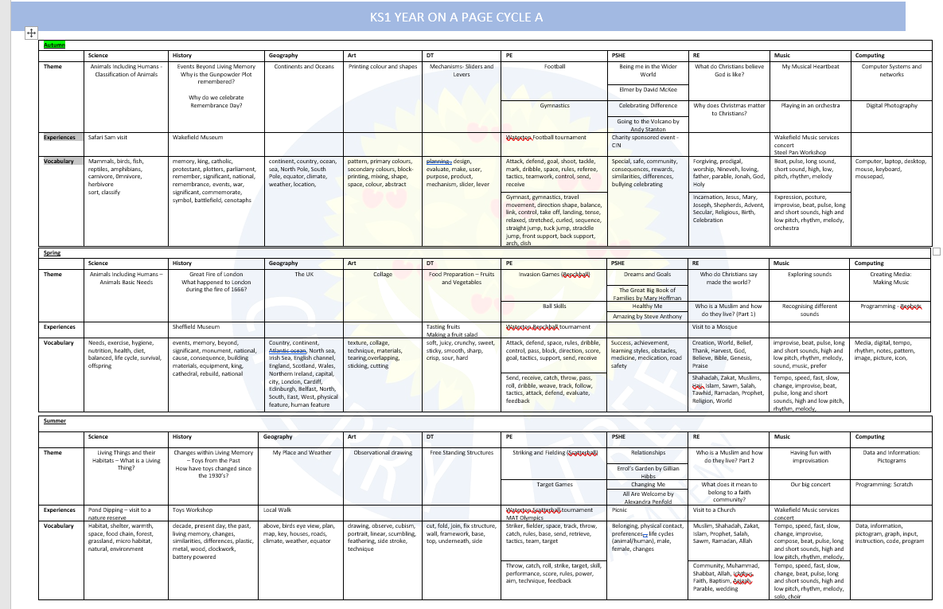

Slide 9
Questions?

