Slide 1
New to Year 3 Parents Meeting
July 2024

Slide 2
Class Structure
Children in Year 3 and now part of Key Stage 2 (KS2)
There will be two classes containing Year 3 children next year.
Y3 / 4 – Class teacher Miss King
Y3/ 4 - Class teacher Miss Hamed
KS1 Leader – Miss King
KS2 Leader – Mrs Wilde

Slide 3
Curriculum
All children in year 3 will have access to the same LKS2 curriculum. All children will cover the same content throughout the year.
Children in year 3 will have access to the same opportunities regardless of which class they are based in.
Teachers will be working closely to plan learning opportunities to ensure this happens.

Slide 4
Differences in KS2 from KS1
Children no longer qualify for universal free school meals. If you think you may be eligible for free school meals please talk to the school office.
Children no longer qualify for free fruit snacks for morning break. Please feel free to send your child with a healthy snack they can eat at morning break (plain crackers, fruits, vegetable sticks, sugar free cereal bars. NO chocolate, crisps or sweets)

Slide 5
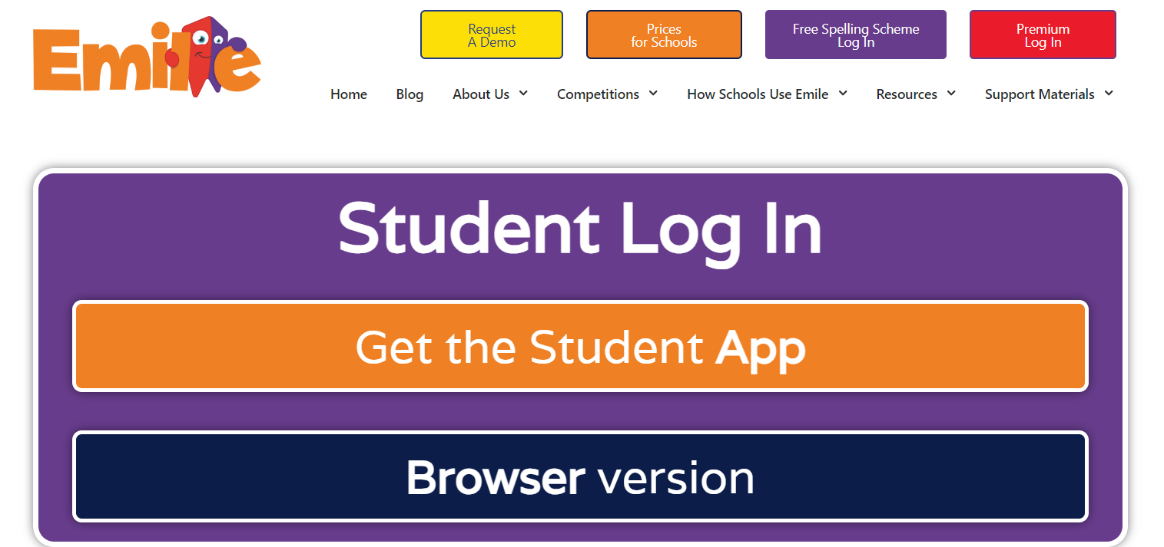
Reading, Spellings and Times tables
It is important that you continue to listen to your child read on a daily basis and set aside time where they spend time reading independently. Talk to them about their reading. Show an interest.
Reading folders, diaries and books need to be brought to school daily.
Spelling homework will be set weekly on Emile. It is an expectation that your child completes this homework every week.
Your child we receive log in information for Times table Rock Stars. It is an expectation that your child completes the times table homework each week.

Slide 6
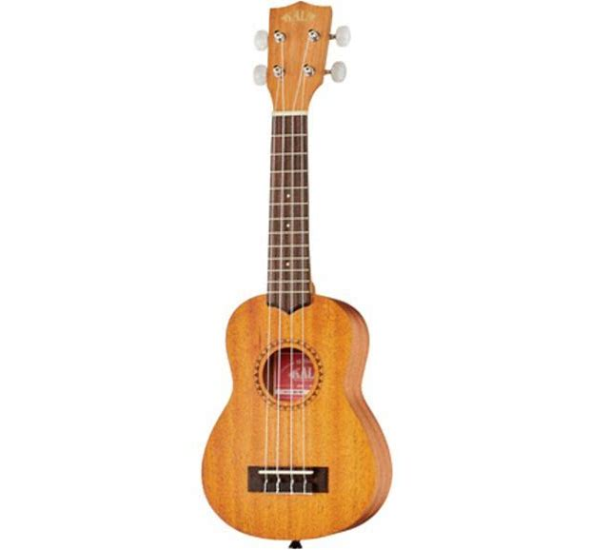
Music
This year in Year 3 your child will be learning to play the ukulele!

Slide 7
PE
PE will take place weekly. Your class teacher will confirm the day and time.
On PE days please ensure earrings are removed or covered.
Please ensure your child has their full PE kit in school.
Please bring PE kits in a drawstring bag. (No backpacks)

Slide 8
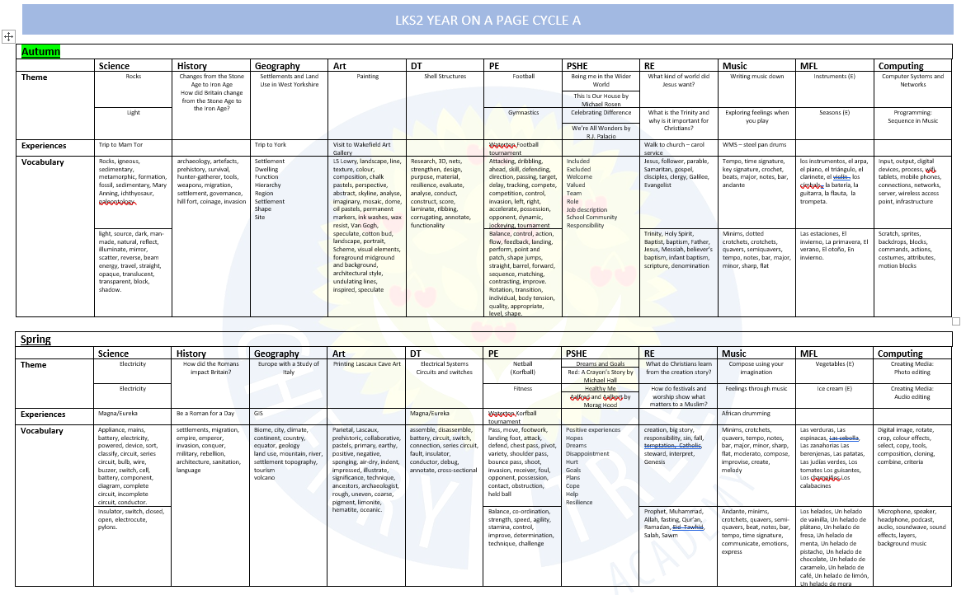

Slide 10
Questions?

